Slide 1
Group 16 Wrap-Up

Slide 2
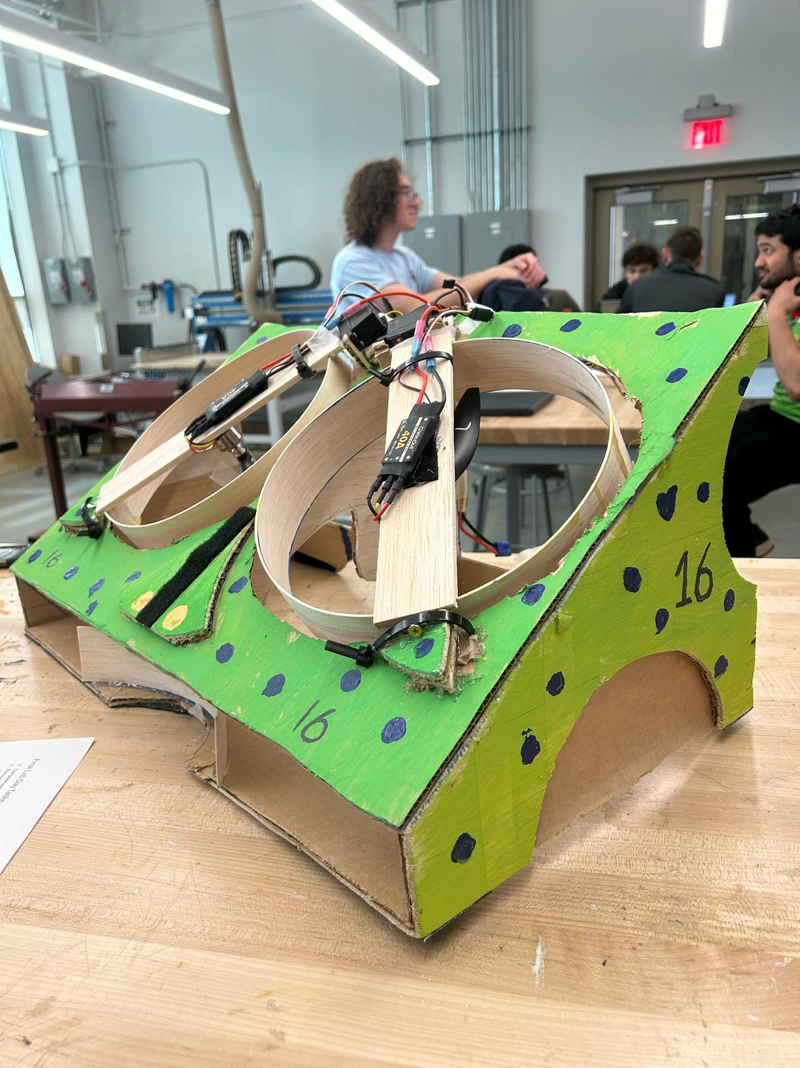
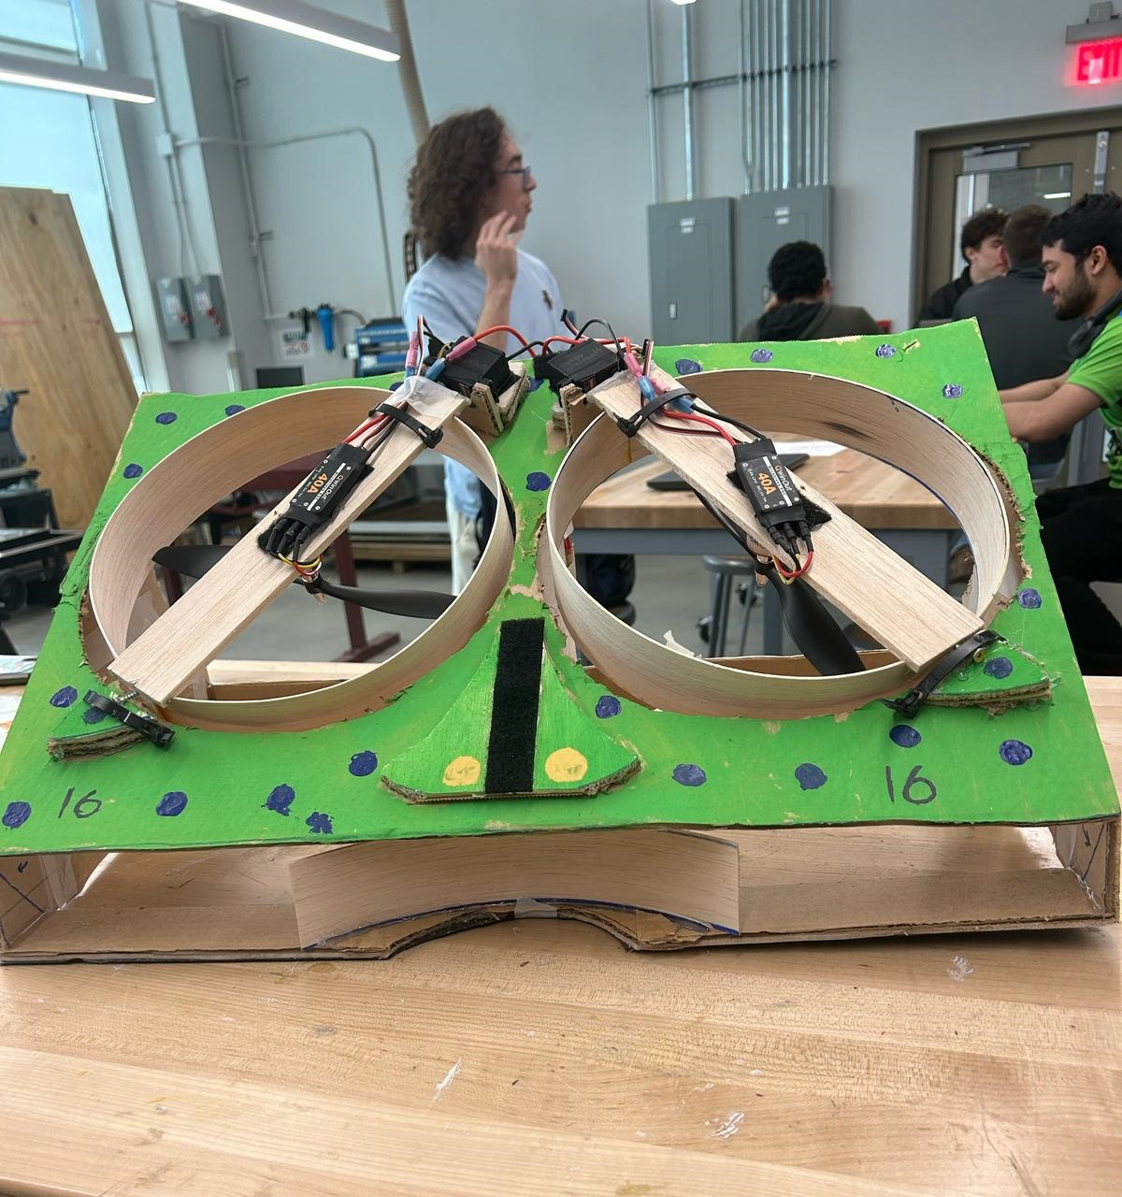
Completed Craft

Slide 3
Design Changes
Pretty much the entire design of the craft changed
From the original PDR presentation:
We removed a third propeller because of budget concerns
The front end was chopped off to fit in bin
Entire craft was put on an angle
2 main propellers were attached on servos to rotate them

Slide 4
Things we would have done differently:
Not redesign the craft 2 weeks before competition
Not make the craft 2 feet wide

Slide 5
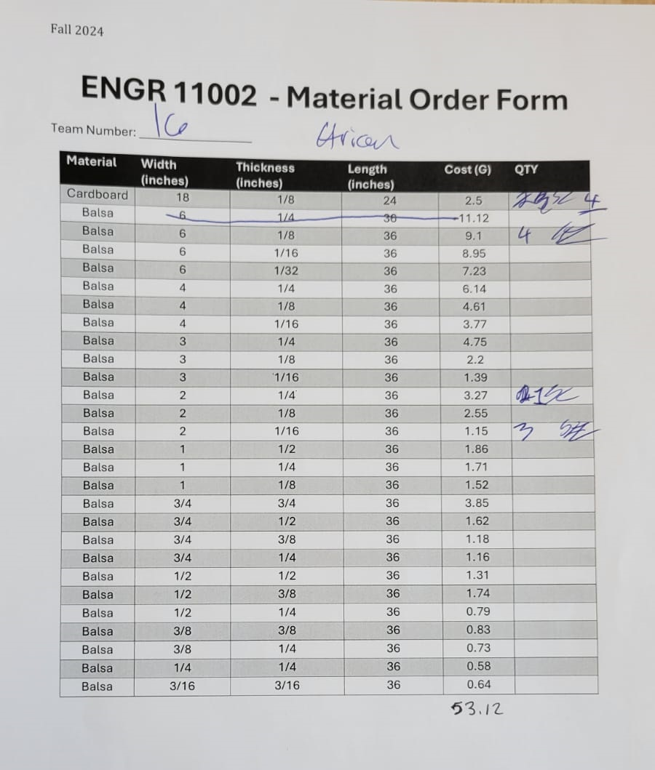
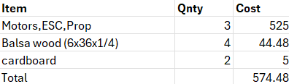
Budget Comparison
PDR Plan: Actual Budget:

Slide 6
Mass Comparison
PDR Plan:
Original Estimate for the mass was 762 g
Actual Mass:
Original mass was exactly 800 g, after trimming some material
it was closer to 730 g

